Slide 1
Data Structure
Soumi Dutta, IEM

Slide 2
BUBBLE SORT
In bubble sort, each element is compared with its adjacent element. If the first element is larger than the second one, then the positions of the elements are interchanged, otherwise it is not changed. Then next element is compared with its adjacent element and the same process is repeated for all the elements in the array until we get a sorted array.
Let A be a linear array of n numbers. Sorting of A means rearranging the elements of A so that they are in order. Here we are dealing with ascending order. i.e., A[0] < A[1] < A[2] < ...... A[n-1].

Slide 3
Steps
Suppose the list of numbers A[0], A[1], A[2], ………… A[n-1] is an element of array A. The bubble sort algorithm works as follows:
Step 1: Compare A[0] and A[1] and arrange them in the (or desired) ascending order, so that A[0] < A[1].that is if A[0] is greater than A[1] then interchange the position of data by swap = A[0]; A[0] = A[1]; A[1] = swap. Then compare A[1] and A[2] and arrange them so that A[1] < A[2]. Continue the process until we compare A[N – 2] with A[N-1].
Note: Step1 contains n – 1 comparisons i.e., the largest element is “bubbled up” to the nth position or “sinks” to the nth position. When step 1 is completed A[N-1] will contain the largest element.
Step 2: Repeat step 1 with one less comparisons that is, now stop comparison at A [n – 2] and possibly rearrange A[N – 3] and A[N – 2] and so on. Note: in the first pass, step 2 involves n–2 comparisons and the second largest element will occupy A[n-2].
And in the second pass, step 2 involves n – 3 comparisons and the 3rd largest element will occupy A[n – 3] and so on. Step n – 1: compare A[0]with A[1] and arrange them so that A[0] < A[1] After n – 1 steps, the array will be a sorted array in increasing (or ascending) order.

Slide 4
Example
The following figures will depict the various steps (or PASS) involved in the sorting of an array of 5 elements. The elements of an array A to be sorted are: 42, 33, 23, 74, 44,66,11
No of Elements : 7
Step 1: 42, 33, 23, 74, 44,66,11
Pass 1: 33, 42, 23, 74, 44,66,11
Pass 2: 33, 23, 42, 74, 44,66,11
Pass 3: 33, 23, 42, 74, 44,66,11
Pass 4: 33, 23, 42, 44, 74,66,11
Pass 5: 33, 23, 42, 44, 66,74,11
Pass 6: 33, 23, 42, 44,66,11,74
No of Elements : N= 7
Step No : S=1
No of Pass = N –S = 6

Slide 5
Example
Step 2: 33, 23, 42, 44,66,11,74
Pass 1: 23, 33, 42, 44,66,11,74
Pass 2: 23, 33, 42, 44,66,11,74
Pass 3: 23, 33, 42, 44,66,11,74
Pass 4: 23, 33, 42, 44,66,11,74
Pass 5: 23, 33, 42, 44,11,66,74
Step 3: 23, 33, 42, 44,11,66,74
Pass 1: 23, 33, 42, 44, 11, 66 ,74
Pass 2: 23, 33, 42, 44, 11, 66, 74
Pass 3: 23, 33, 42, 44, 11, 66, 74
Pass 4: 23, 33, 42, 11, 44, 66,74
No of Elements : N= 7
Step No : S=2
No of Pass = N –S = 5
No of Elements : N= 7
Step No : S=3
No of Pass = N –S = 4

Slide 6
Example
Step 4: 23, 33, 42, 11, 44, 66,74
Pass 1: 23, 33, 42, 11, 44, 66, 74
Pass 2: 23, 33, 42, 11, 44, 66, 74
Pass 3: 23, 33, 11, 42, 44, 66, 74
Step 5: 23, 33, 11, 42, 44, 66, 74
Pass 1: 23, 33, 42, 44, 11, 66 ,74
Pass 2: 23, 11, 33, 42, 44, 66, 74
Step 6: 23, 11, 33, 42, 44, 66, 74
Pass 1: 11, 23, 42, 44, 11, 66 ,74
No of Elements : N= 7
Step No : S=4
No of Pass = N –S = 3
No of Elements : N= 7
Step No : S=5
No of Pass = N –S = 2
No of Elements : N= 7
Step No : S=6
No of Pass = N –S = 1

Slide 7
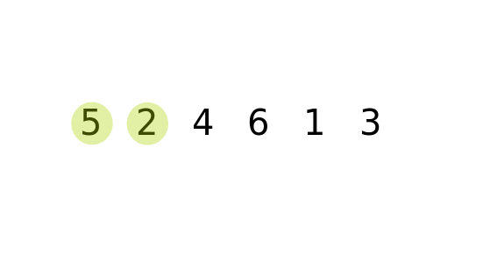
Example

Slide 8
BUBBLE SORT ALGORITHM
Let A be a linear array of n numbers. Swap is a temporary variable for swapping (or interchange) the position of the numbers.
1. Input n numbers of an array A
2. Initialize i = 0 and repeat through step 4 if (i < n)
3. Initialize j = 0 and repeat through step 4 if (j < n – i – 1)
4. If (A[j] > A[j + 1])
(a) Swap = A[j]
(b) A[j] = A[j + 1]
(c) A[j + 1] = Swap
5. Display the sorted numbers of array A
6. Exit.

Slide 9
Coding
#define n 10
void main()
{
int value[n], i,j,temp;
printf("\n Enter the elements\n");
for (i = 0; i < n; i++)
scanf("%d", &value[i]);
printf("\n Sorted list is as follows\n");
for (i = 0; i < n; i++)
printf("%d ", value[i]);
getch();
}
for (i = 0; i < n; i++) { // No of steps
for (j = 0; j < n-i-1; j++) { // No of Passes
if (value[j+1] < value[j])
{
temp = value[j+1];
value[j+1] = value[j];
value[j] = temp;
}
}
}

Slide 10
Bubble Sort Complexity
BEST CASE
In this case you are asked to sort a sorted array by bubble sort algorithm. The inner loop will iterate with the ‘if’ condition evaluating time, that is the swap procedure is never called. In best case outer loop will terminate after one iteration, i.e., it involves performing one pass, which requires n–1 comparisons
f (n) = O(n)
WORST CASE
In this case the array will be an inverted list (i.e., 5, 4, 3, 2, 1, 0). Here to move first element to the end of the array, n–1 times the swapping procedure is to be called. Every other element in the list will also move one location towards the start or end of the loop on every iteration. Thus n times the outer loop will iterate and n (n-1) times the inner loop will iterate to sort an inverted array.
f(n)= (n-1)+(n-2)+(n-3)+…………..+2+1
=n(n-1)/2 = O(n²)

Slide 11
Bubble Sort Complexity
AVERAGE CASE
Average case is very difficult to analyze than the other cases. In this case the input data(s) are randomly placed in the list. The exact time complexity can be calculated only if we know the number of iterations, comparisons and swapping. In general, the complexity of average case is:
f(n)= (n-1)+(n-2)+(n-3)+…………..+2+1
=n(n-1)/2 = O(n²)

Slide 12
SELECTION SORT
The selection sort algorithm sorts an array by repeatedly finding the minimum element (considering ascending order) from unsorted part and putting it at the beginning. The algorithm maintains two subarrays in a given array.
  1) The subarray which is already sorted.
  2) Remaining subarray which is unsorted.
In every iteration of selection sort, the minimum element (considering ascending order) from the unsorted subarray is picked and moved to the sorted subarray.

Slide 13
SELECTION SORT
Selection sort algorithm finds the smallest element of the array and interchanges it with the element in the first position of the array. Then it finds the second smallest element from the remaining elements in the array and places it in the second position of the array and so on. Let A be a linear array of ‘n’ numbers, A[0], A [1], A [2], A [3],...... A [n-1].
Step 1: Find the smallest element in the array of n numbers A[0], A[1], A[2], ...... A[n-1]. Let LOC is the location of the smallest number in the array. Then interchange A[LOC] and A[0] by swap = A[LOC]; A[LOC] = A[0]; A[0] = Swap.
Step 2: Find the second smallest number in the sub list of n – 1 elements A [1] A [2] ...... A [n – 1] Again A [LOC] is the smallest element in the remaining array and LOC the corresponding location then interchange A [LOC] and A [1]. Now A [0] and A [1] is sorted, since A [0] less than or equal to A [1].
Step 3: Repeat the process by reducing one element each from the array
Step n – 1: Find the n – 1 smallest number in the sub array of 2 elements (i.e., A(n–2), A (n-1)). Consider A [LOC] is the smallest element and LOC is its corresponding position. Then interchange A [LOC] and A(n – 2). Now the array A[0], A [1], A [2], A [3], A [4],………..A [n-1] will be a sorted array.

Slide 14
Example
arr[] = 64 25 12 22 11
// Find the minimum element in arr[0...4]
// and place it at beginning
Step 1: 11 25 12 22 64
// Find the minimum element in arr[1...4]
// and place it at beginning of arr[1...4]
Step 2: 11 12 25 22 64
// Find the minimum element in arr[2...4]
// and place it at beginning of arr[2...4]
Step 3: 11 12 22 25 64
// Find the minimum element in arr[3...4]
// and place it at beginning of arr[3...4]
Step 4: 11 12 22 25 64

Slide 15
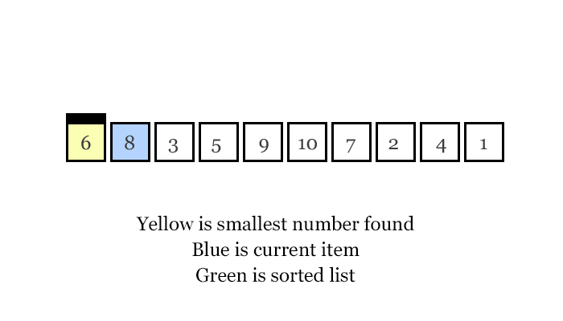
Example

Slide 16
SELECTION SORT ALGORITHM
Let A be a linear array of n numbers A [1], A [2], A [3], ……… A [k], A [k+1], …….. A [n]. Swap
be a temporary variable for swapping (or interchanging) the position of the numbers. Min is the variable to store smallest number and Loc is the location of the smallest element.
1. Input n numbers of an array A
2. Initialize i = 0 and repeat through step5 if (i < n – 1)
  (a) min = a[i]
  (b) loc = I
3. Initialize j = i + 1 and repeat through step 4 if (j < n – 1)
4. if (a[j] < min)
  (a) min = a[j]
  (b) loc = j
5. if (loc ! = i)
  (a) swap = a[i]
  (b) a[i] = a[loc]
  (c) a[loc] = swap
6. display “the sorted numbers of array A”
7. Exit

Slide 17
Coding
#define n 5
void main() {
int arr[n], i,k,temp, smallest;
printf("\n Enter the elements\n");
for (i = 0; i < n; i++)
scanf("%d", &arr [i]);
printf("\n Sorted list is as follows\n");
for (i = 0; i < n; i++)
printf("%d ", arr[i]);
getch();
}
for (i = 0; i < n – 1 ; i++) {
smallest = i;
for(k = i + 1; k < n ; k++) {
if (arr[smallest] > arr[k])
smallest = k ;
}
if ( i != smallest ) {
temp = arr [i];
arr[i] = arr[smallest];
arr[smallest] = temp ;
}
}

Slide 18
Selection Sort Complexity
Time complexity of a selection sort is calculated in terms of the number of comparisons f(n). In the first pass it makes n – 1 comparisons; the second pass makes n – 2 comparisons and so on. The outer for loop iterates for (n - 1) times. But the inner loop iterates for n*(n – 1) times to complete the sorting.
f (n) = (n – 1) + (n – 2) + ...... + 2 + 1
= (n(n – 1))/2
= O(n²)
In worst case we can analyze how the algorithm is performed for reverse sorted array as input. Average case is where we input general (mixed sorted) input to the algorithm.
Following table will summarize the efficiency of algorithm in different case :
Best case | Worst case | Average case
O(n²) | O(n²) | O(n²)

Slide 19
INSERTION SORT
Insertion sort algorithm sorts a set of values by inserting values. Compare the second element with first, if the first element is greater than second, place it before the first one. Otherwise place is just after the first one. Compare the third value with second. If the third value is greater than the second value then place it just after the second. Otherwise place the second value to the third place. And compare third value with the first value. If the third value is greater than the first value place the third value to second place, otherwise place the first value to second place. And place the third value to first place and so on.
Let A be a linear array of n numbers A [0], A [1], A [2], A [3], ...... A[n-1]. The algorithm scan the array A from A [0] to A [n-1], by inserting each element A[k], into the proper position of the previously sorted sub list. A [0], A [1], A [2], A [3], ...... A [k – 1]

Slide 20
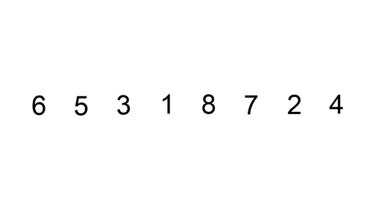
Example

Slide 21
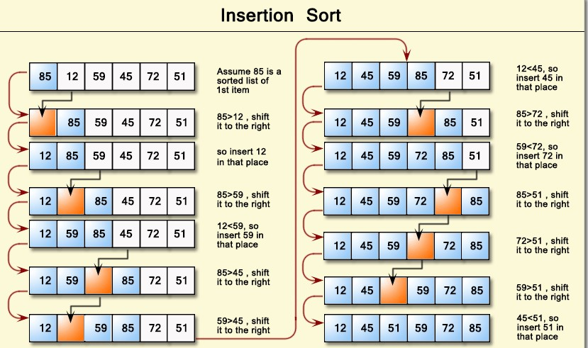
Example

Slide 22
Example
Since is the first element has no other element to be compared with, it remains at its position. Now when on moving towards , is the largest element in the sorted list and greater than . So, move to its correct position i.e. before . Similarly with , as (largest element in the sorted list) is greater than , we will move to its correct position. Finally for , all the elements on the left side of (sorted list) are moved one position forward as all are greater than and then is placed in the first position. Finally, the given array will result in a sorted array.

Slide 23
INSERTION SORT ALGORITHM
Let A be a linear array of n numbers A [0], A [1], A [2], A [3], ...... ,A [n-1]......Swap be a temporary
variable to interchange the two values. Pos is the control variable to hold the position of
each pass.
1. Input an array A of n numbers
2. Initialize i = 1 and repeat through steps 4 by incrementing i by one.
(a) If (i < = n – 1)
(b) Swap = A [I],
(c) Pos = i – 1
3. Repeat the step 3 if (Swap < A[Pos] and (Pos >= 0))
(a) A [Pos+1] = A [Pos]
(b) Pos = Pos-1
4. A [Pos +1] = Swap
5. Exit

Slide 24
Coding
#define N 5
void main() {
  int A[5], Temp, i, j,k;
  printf("\n\t ENTER THE ELEMENTS OF THE ARRAY...\n:");
  for(i=0; i<N; i++)
  scanf("%d", &A[i]);
printf("\n\t THE ASCENDING ORDER LIST IS...:\n");
for(i=0; i<N; i++)
printf("\n\t\t\t%d", A[i]);
getch();
}
for(i=1; i<N; i++) {
for(j=i; j>0 && A[j-1]>A[j]; j--) {
Temp=A[j-1];
A[j-1] = A[j];
A[j]=Temp;
}
}
}

Slide 25
Insertion Sort Complexity
WORST CASE
The worst case occurs when the array A is in reverse order and the inner while loop must use the maximum number (n – 1) of comparisons. Hence
f(n) = (n – 1) + ....... 2 + 1
= (n (n – 1))/2
= O(n2)
AVERAGE CASE
On the average case there will be approximately (n – 1)/2 comparisons in the inner while loop. Hence the average case
f (n) = (n – 1)/2 + ...... + 2/2 +1/2
= n (n – 1)/4
= O(n2)
BEST CASE
The best case occurs when the array A is in sorted order and the outer for loop will iterate for (n – 1) times. And the inner while loop will not execute because the given array is a sorted array
i.e., f (n) = O(n).

Slide 26
Divide-and-conquer algorithms
The divide-and-conquer strategy solves a problem by:
1. Breaking it into sub problems that are themselves smaller instances of the same type of problem
2. Recursively solving these sub problems
3. Appropriately combining their answers
The real work is done piecemeal, in three different places: in the partitioning of problems into sub problems; at the very tail end of the recursion, when the sub problems are so small that they are solved outright; and in the gluing together of partial answers. These are held together and coordinated by the algorithm's core recursive structure.

Slide 27
Quick SORT
The quick sort uses divide and conquer to gain the same advantages as the merge sort, while not using additional storage.
A quick sort first selects a value, which is called the pivot value. Although there are many different ways to choose the pivot value, we will simply use the first item in the list. The role of the pivot value is to assist with splitting the list. The actual position where the pivot value belongs in the final sorted list, commonly called the split point, will be used to divide the list for subsequent calls to the quick sort.

Slide 28

Quick SORT
Figure shows that 54 will serve as our first pivot value. Since we have looked at this example a few times already, we know that 54 will eventually end up in the position currently holding 31. The partition process will happen next. It will find the split point and at the same time move other items to the appropriate side of the list, either less than or greater than the pivot value.
Notes:
Quick Sort

Slide 29
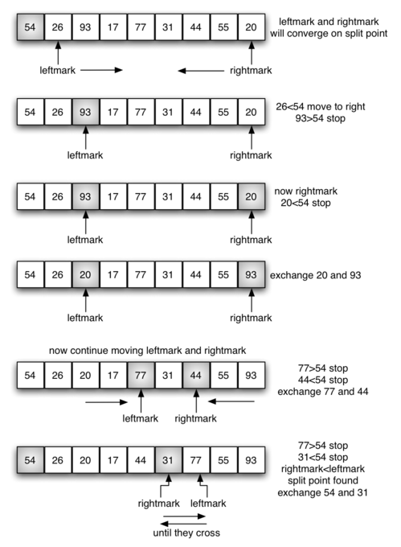
Quick SORT
Partitioning begins by locating two position markers—let’s call them leftmark and rightmark—at the beginning and end of the remaining items in the list (positions 1 and 8 in Figure). The goal of the partition process is to move items that are on the wrong side with respect to the pivot value while also converging on the split point. Figure shows this process as we locate the position of 54.
Notes:
Quick Sort

Slide 30
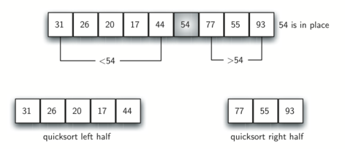
Quick SORT
Notes:
Quick Sort

Slide 31
Quick SORT
We begin by incrementing leftmark until we locate a value that is greater than the pivot value. We then decrement rightmark until we find a value that is less than the pivot value. At this point we have discovered two items that are out of place with respect to the eventual split point. For our example, this occurs at 93 and 20. Now we can exchange these two items and then repeat the process again.
At the point where rightmark becomes less than leftmark, we stop. The position of rightmark is now the split point. The pivot value can be exchanged with the contents of the split point and the pivot value is now in place. In addition, all the items to the left of the split point are less than the pivot value, and all the items to the right of the split point are greater than the pivot value. The list can now be divided at the split point and the quick sort can be invoked recursively on the two halves.
Notes:
Quick Sort

Slide 32
Coding
#include<stdio.h>
#include<conio.h>
#include<stdlib.h>
int main(){
int i, count=12, number[12]={44,33,11,55,77,90,40,60,99,22,88,66};
printf("\n Unsorted list is as follows \n");
for (i = 0; i < 12; i++)
{
printf(" %d, ", number[i]);
}
quicksort(number,0,11);
printf("\n Order of Sorted elements: \n");
for(i=0;i<count;i++)
printf(" %d, ",number[i]);
return 0;
}

Slide 33
Coding
void quicksort(int number[12],int first,int last){
int i, j, pivot, temp,k;
if(first<last){
pivot=first;
i=first;
j=last;
while(i<j){
while(number[i]<= number[pivot]&&i<last)
i++;
while(number[j]>number[pivot])
j--;
if(i<j){
temp=number[i];
number[i]=number[j];
number[j]=temp;
}
}
temp=number[pivot];
number[pivot]=number[j];
number[j]=temp;
quicksort(number,first,j-1);
quicksort(number,j+1,last);
}
}

Slide 34
Quick Sort Algorithm
Let A be a linear array of n elements A (1), A (2), A (3)......A (n), low represents the
lower bound pointer and up represents the upper bound pointer. Key represents the first element of the array, which is going to become the middle element of the sub-arrays.
1. Input n number of elements in an array A
2. Initialize low = 2, up = n , key = A[low]
3. Repeat through step 8 while (low < = up)
4. Repeat step 5 while(A [low] > key)
5. low = low + 1
6. Repeat step 7 while(A [up] < key)
7. up = up–1
8. If (low < = up)
  (a) Swap = A [low]
  (b) A [low] = A [up]
  (c) A [up] = swap
  (d) low=low+1
  (e) up=up–1
9. If (1 < up) Quick sort (A, 1, up)
10. If (low < n) Quick sort (A, low, n)
11. Exit

Slide 35
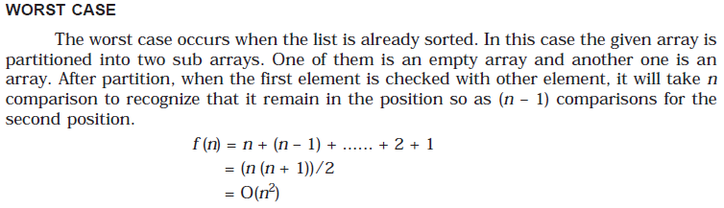
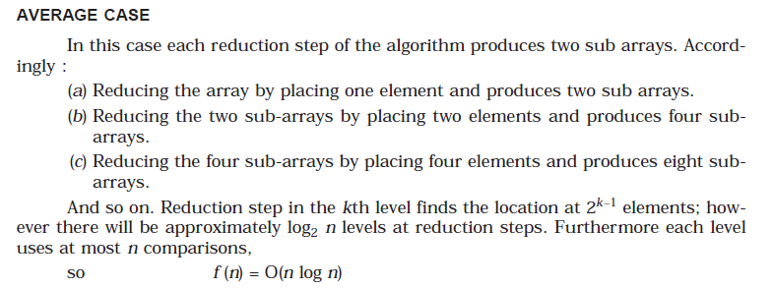
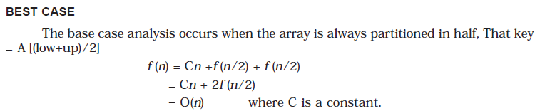
Quick Sort Complexity

Slide 36
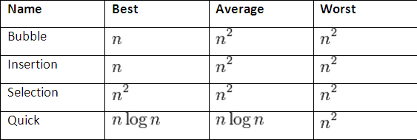
Comparison of algorithms
In this table, n is the number of records to be sorted. The columns "Average" and "Worst" give the time complexity in each case, under the assumption that the length of each key is constant, and that therefore all comparisons, swaps, and other needed operations can proceed in constant time. "Memory" denotes the amount of auxiliary storage needed beyond that used by the list itself, under the same assumption. The time complexity of quick sort can be calculated for any of the following case. It is usually measured by the number f (n) of comparisons required to sort n elements.
By Soumi Dutta

Slide 37
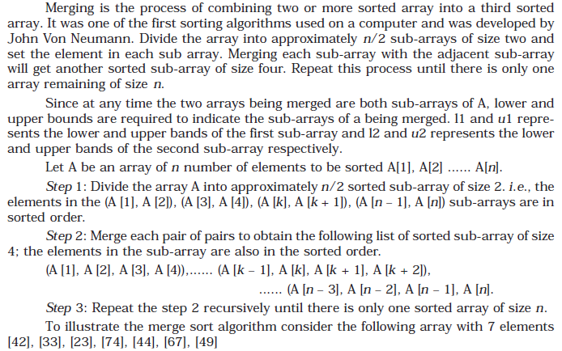
MERGE SORT

Slide 38
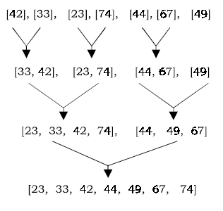
MERGE SORT

